Slide 1


VISVESVARAYA TECHNOLOGICAL UNIVERSITY BELAGAVI - 590014
A TECHNICAL SEMINAR PRESENTATION ON
Monolithic 3D Integrated Circuits: Recent Trends and Future Prospects
Department of Electronics & Communication Engineering
S.D.M Institute Of Technology, Ujire
Presented by
Sharath Krishna Naik
4SU21EC076
Guide Name
Mr. Raghuveera Pandith

Slide 2
CONTENTS
Introduction
Literature Survey
Open-Source Cell Library for Monolithic 3D Ics
Mono-3D Fabrication Process
Mono3D Design Methodologies
Applications for Mono3D and Future Scope
Conclusion

Slide 3
Introduction
MONO3D enables vertical stacking of transistors on the same wafer using standard CMOS processes—no TSVs needed.
Traditional 2D IC fabrication is reaching physical limits as transistor sizes shrink below 10nm.
TSV-based and 2.5D integration techniques offer performance gains but are limited by TSV size and alignment complexity.
MONO3D supports transistor-level, gate-level, and block-level integration, allowing different trade-offs in complexity and optimization.
MIVs provide ultra-dense vertical connections, enabling high-performance, energy-efficient, and compact IC designs.

Slide 4
Literature Survey
SL.NO | Paper and Authors | Year of publication | Publication | Learning
1. | “IEEE Std P1838: DfT standard under-development for 2.5D-, 3D-, and 5.5D-SICs,” E. J. Marinissen, T. McLaurin, and H. Jiao, | 2016 | IEEE | IEEE Std P1838 stands for IEEE Standard for Test Access and Data Exchange for Stacked Integrated Circuits (ICs). This standard provides guidelines for testing stacked ICs, including those with 2.5D, 3D, and 5.5D architectures, ensuring efficient and scalable test access across multiple chip layers.
2. | “Metal stack and partitioning exploration for monolithic 3D ICs,”. N. K. Sketopoulos, C. P. Sotiriou, and V. F. Pavlidis | 2020 | IEEE | The paper explores metal stack and partitioning strategies for optimizing monolithic 3D IC designs, focusing on performance, power efficiency, and thermal management. It demonstrates how optimal configurations improve interconnectivity, signal integrity, and manufacturability.

Slide 5
Open-Source Cell Library for Monolithic 3D ICs
Library development
Built on 45nm FreePDK45 – Developed using NCSU’s open-source 45nm process.
Two-Tier Layout – PMOS in bottom tier, NMOS in top tier for better performance and thermal handling.
Uses MIVs – Tiny vertical vias (50nm × 215nm) for efficient layer connections.
Non-Overlapping Power Rails – Power and ground placed on separate tiers to avoid interference.
Includes 20 Standard Cells – Available in three variants (v1, v2, v3) for flexible routing and layout.

Slide 6
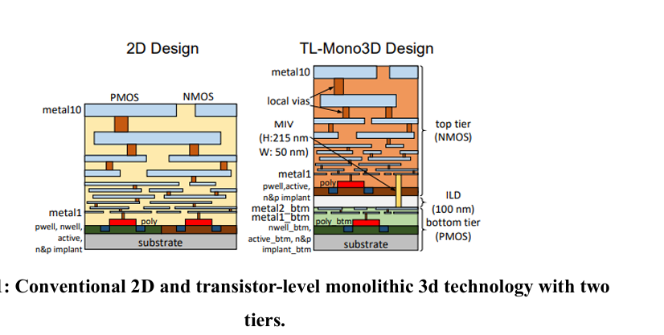
2D Design
PMOS and NMOS transistors are placed side by side on a single layer.
Metal layers (metal1 to metal10) are stacked above the transistors to make all the necessary connections.
TL-Mono3D Design (Two Tiers)
NMOS transistors are in the top tier, and PMOS transistors are in the bottom tier (split vertically).
MIVs (Monolithic Inter-Tier Vias) connect the two layers.
Height = 215 nm, Width = 50 nm – very small and dense.
The layers are separated by ILD (Inter-Layer Dielectric), 100 nm thick.

Slide 7
2. Design Flow
New Tech Files: Added layers for MIVs and 3D structure in .tf and .drf files.
MIV Specs: Resistance = 5.5 Ω, Capacitance = 0.04 fF.
RC Extraction: Modeled key parasitics skipped negligible tier-to-tier coupling.
Library Generation: Used ELC for .lib, converted to .db for EDA tools.
DRC & LVS Updates: Verified new 3D rules, MIV spacing = 120 nm

Slide 8
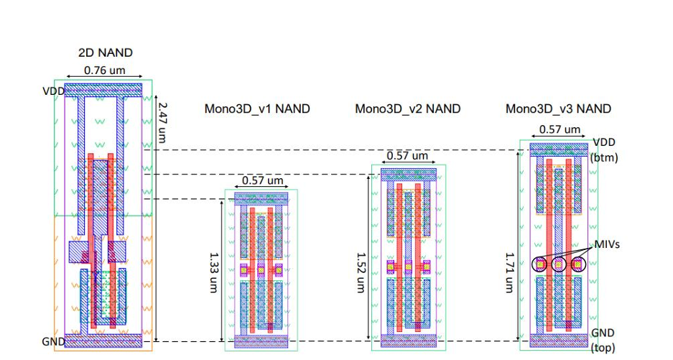
The NAND gate layouts show progressive height reduction from 2D (2.47 µm) to Mono3D versions (v1: 1.33 µm, v2: 1.52 µm, v3: 1.71 µm) while width is consistently reduced to 0.57 µm in all Mono3D variants.
Mono3D_v3 uses MIVs (Monolithic Inter-tier Vias) to connect layers, enabling vertical power delivery (VDD at bottom, GND at top), illustrating 3D integration trade-offs in layout complexity vs. area savings

Slide 9
3. Cell-Level Evaluation
Mono3D integration significantly reduces cell area, with v1, v2, and v3 averaging 32%, 22%, and 14% reduction respectively.
Negative area reductions arise in some cases where increased width offsets height compression, mainly due to MIV and routing overhead.
Delay increases slightly for all variants due to added coupling capacitance and MIV impedance, with v1 showing the least increase at 2.15%.
Power consumption decreases, especially in v1 (by 0.93%), owing to shorter interconnect lengths in 3D structures.
Performance gains or losses vary by cell architecture, layout, and MIV placement, making optimization cell-specific.

Slide 10
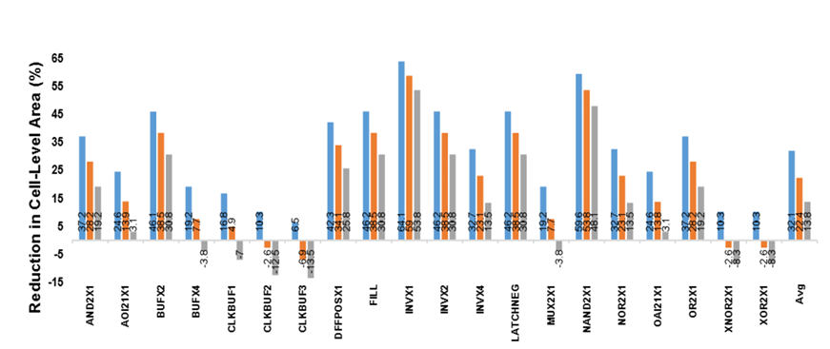
The bar chart shows the cell-level area reduction (%) for different standard cells using Mono3D v1, v2, and v3 compared to traditional 2D cells.
Orange, blue, and gray bars represent Mono3D v1, v2, and v3 respectively, showing variation in area savings across different cell types.
Some cells exhibit negative reduction (area increase), due to increased cell width despite reduced height to accommodate MIVs and routing constraints.

Slide 11
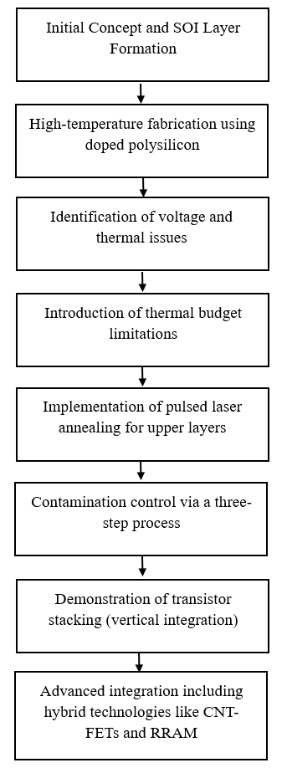
Mono-3D Fabrication Process

Slide 12
Mono3D Design Methodologies
1. Physical Design
Tools and Techniques: Pseudo-3D design tools like S2D, Compact-2D, and Cascade2D adapt 2D place-and-route flows for MONO3D, balancing power, performance, and area trade-offs.
Tier Partitioning: nMOS and I/O pins are placed in the top tier, pMOS in the bottom, with MIVs ensuring vertical connectivity, enabling compatibility with conventional 2D CAD tools.
Routing Optimization: Increasing routing tracks per cell improves timing and reduces congestion, achieving up to 37% footprint reduction and 13% lower power than 2D counterparts.

Slide 13
2. Thermal Integrity
Thermal Challenges: High device density and close vertical spacing cause thermal coupling, demanding precise modeling of hotspot propagation between tiers.
Thermal Management Techniques: Use of nano-pillars and optimized power delivery networks (PDNs) can lower temperature by up to 53% through strategic heat dissipation.
Modeling and Simulation: HotSpot-6.0 and FEM simulations show that thermal effects in MONO3D are bidirectional, making thermal-aware design critical for reliability.
3. Design-for-Test (DFT)
Testing Complexity: MONO3D's dense MIV network introduces faults (opens, shorts, stuck-at) not easily addressed by traditional ATPG tools.
BIST Approaches: Dual-BIST architecture offers high fault coverage with low overhead (max 2.6% area, 9% power), using XOR gates and compact signatures.

Slide 14
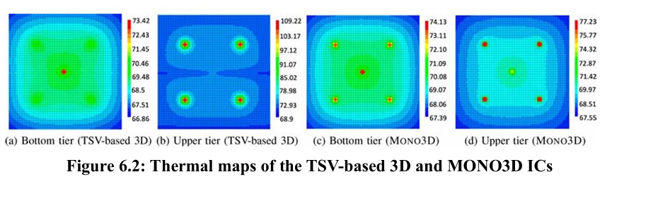
presents thermal maps of TSV-based 3D and MONO3D ICs, highlighting how MONO3D exhibits better heat dissipation through strong vertical thermal coupling, but also reveals the challenge of hot spot propagation between tiers due to thin inter-layer dielectric.
Mono3D (bottom images) spreads the heat more evenly, avoiding overheating in upper layers, which is common in TSV-based 3D ICs.
This means Mono3D can cool down better and is safer for high-performance chips

Slide 15
Applications for Mono3D and Future Scope
Near- and In-Memory Computing
Deep Neural Networks (DNNs)
Hardware Security
Future scope:
Integrate design and fabrication processes for better efficiency.
Develop accurate models for layer-wise performance and thermal behavior.
Create advanced tools for energy-efficient and high-performance chip design.
Disadvantage:
Complex Fabrication Process and Testing Challenges
Limited Design Tool Support.
Thermal Management Issues,

Slide 16
Conclusion
Mono3D offers high performance, compact size, and energy efficiency through vertical integration.
Key challenges include thermal limits, contamination, and lack of design-tool support.
Stronger alignment between fabrication and design is needed for real-world adoption.
Mono3D FFT128 is just a more compact, power-efficient, and faster version of a traditional FFT chip-achieved by building it in 3D layers instead of flat 2D.

Slide 17
Thank You

